Slide 1
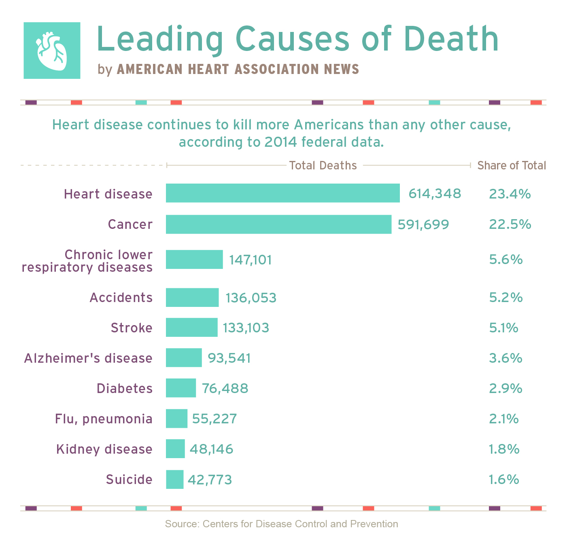

Slide 2
Cause Of Deaths Report.
Submitted by :-
Saraswathy L

Slide 3
A straightforward way to assess the health status of a population is to focus on mortality – or concepts like child mortality or life expectancy, which are based on mortality estimates. A focus on mortality, however, does not take into account that the burden of diseases is not only that they kill people, but that they cause suffering to people who live with them. Assessing health outcomes by both mortality and morbidity (the prevalent diseases) provides a more encompassing view on health outcomes. This is the topic of this entry. The sum of mortality and morbidity is referred to as the ‘burden of disease’ and can be measured by a metric called ‘disability adjusted life years‘ (dalys).
DALYs are measuring lost health and are a standardized metric that allow for direct comparisons of disease burdens of different diseases across countries, between different populations, and over time. Conceptually, one DALY is the equivalent of losing one year in good health because of either premature death or disease or disability. One DALY represents one lost year of healthy life. The first ‘Global burden of disease’ (Gbd) was Gbd 1990 and the daly metric was prominently featured in the world bank’s 1993 World Development Report. Today it is published by both the researchers at the Institute of Health Metrics and evaluation (ihme) and the ‘disease burden unit’ at the world Health Organization (WHO), which was created in 1998. The IHME continues the work that was started in the early 1990s and publishes the Global Burden of Disease study.

Slide 4
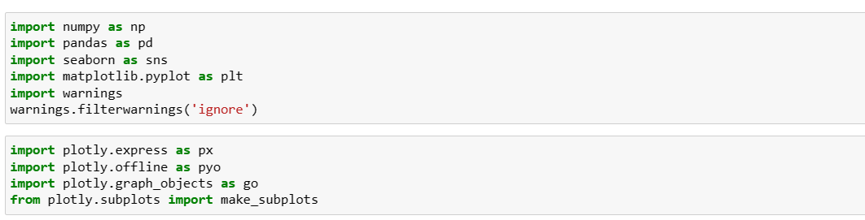
Content :-
In this Dataset, we have Historical Data of different cause of deaths for all ages around the World. The key features of this Dataset are: Meningitis, Alzheimer's Disease and Other Dementias, Parkinson's Disease, Nutritional Deficiencies, Malaria, Drowning, Interpersonal Violence, Maternal Disorders, HIV/AIDS, Drug Use Disorders, Tuberculosis, Cardiovascular Diseases, Lower Respiratory Infections, Neonatal Disorders, Alcohol Use Disorders, Self-harm, Exposure to Forces of Nature, Diarrheal Diseases, Environmental Heat and Cold Exposure, Neoplasms, Conflict and Terrorism, Diabetes Mellitus, Chronic Kidney Disease, Poisonings, Protein-Energy Malnutrition, Road Injuries, Chronic Respiratory Diseases, Cirrhosis and Other Chronic Liver Diseases, Digestive Diseases, Fire, Heat, and Hot Substances, Acute Hepatitis.
IMPORTING SOME OF THE IMPORTANT LIBARARIES:-

Slide 5
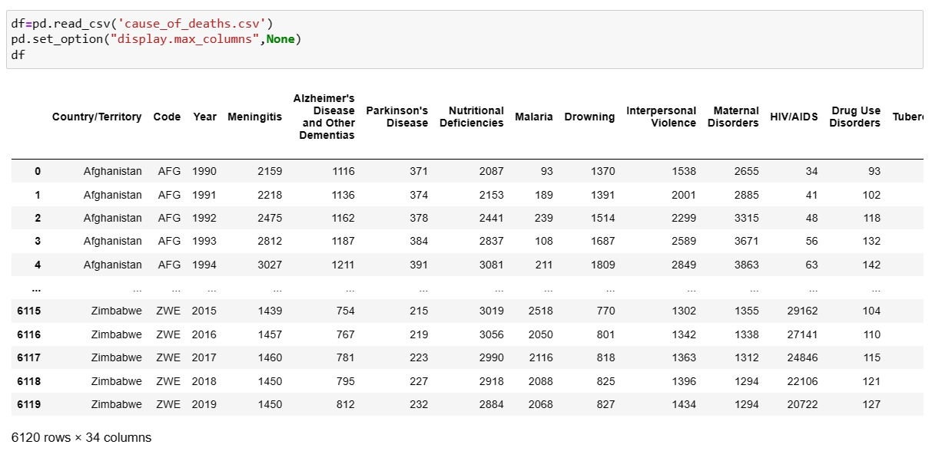
IMPORTING THE DATASET WITH DISPLAY MAX COLUMNS AS THERE ARE 34 COLUMNS IN THE DATASET :-
DOING SOME SHUFFLING OF THE DATASET TO SEE ANY ABNORMAL VALUES PRESENT IN THE DATASET :-

Slide 6
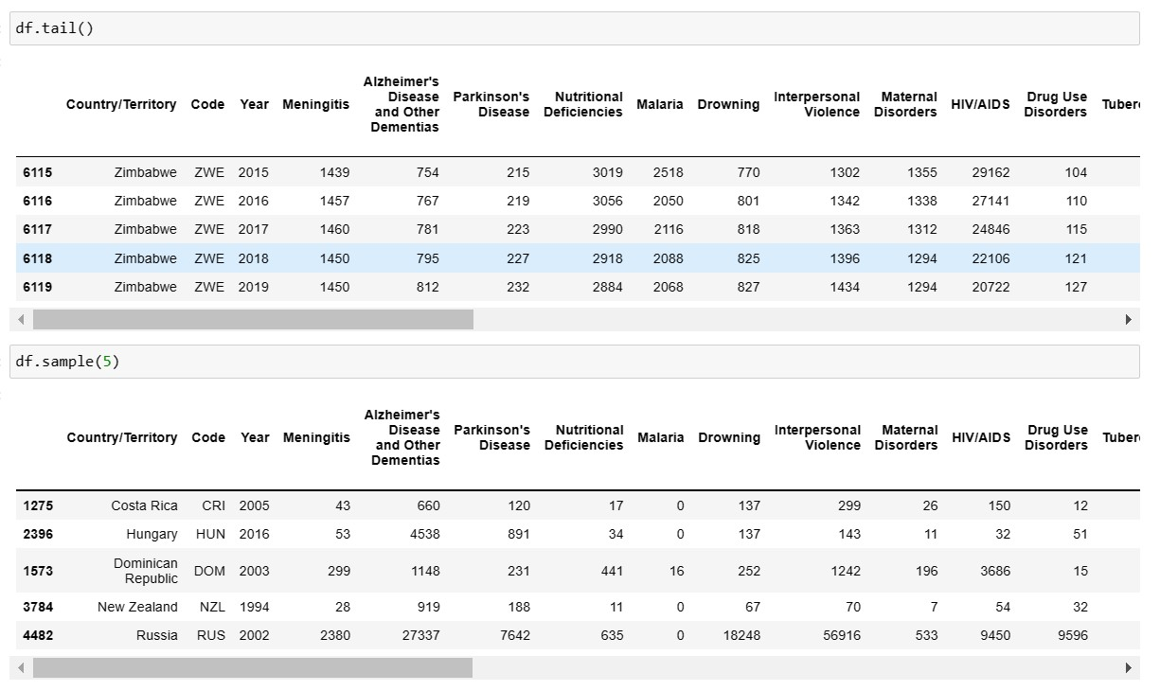
CHECKING OUT THE DATA TYPES OF THE COLUMNS IN THE DATASET :-

Slide 7
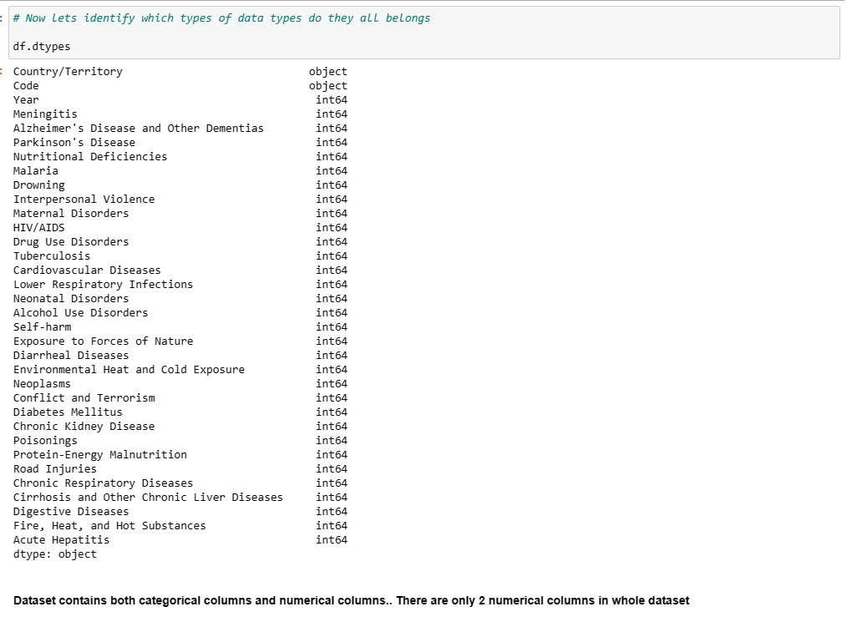
HERE WE CAN SEE THAT THERE ARE 2 OBJECT COLUMNS AND REST ALL THE OTHER COLUMNS ARE NUMERICAL COLUMNS.

Slide 8
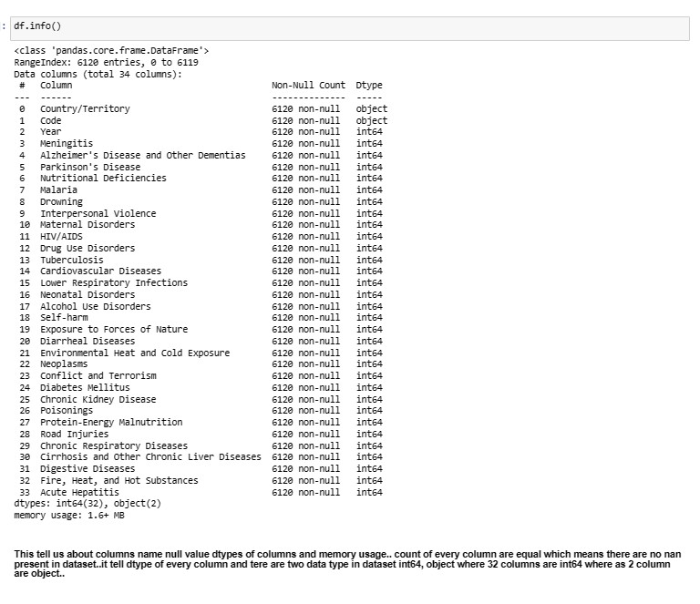
LETS CHECK THE INFO OF THE DATASET AND HERE WE GET TO KNOW ABOUT THE DATA TYPE AND COUNTS OF THE COLUMN:-

Slide 9
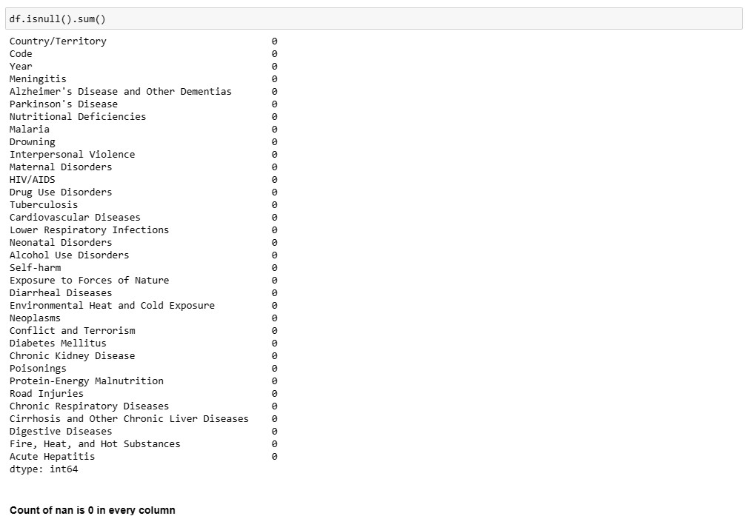
LETS CHECK NULL VALUES IN THE DATASET:-

Slide 10
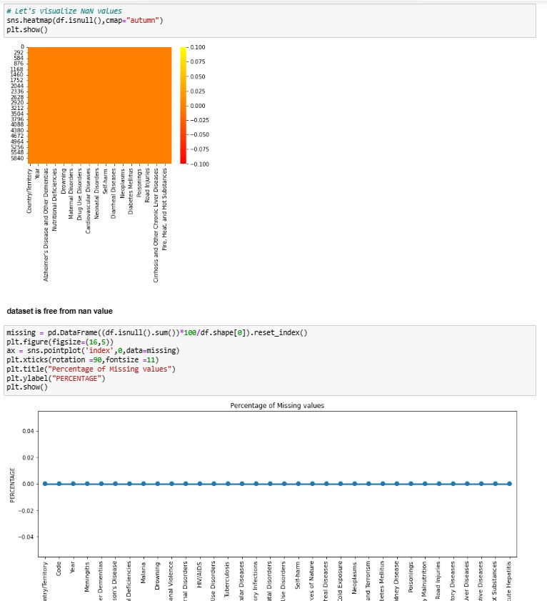
HERE WE CAN SEE THAT 0 NAN VALUES ARE PRESENT IN THE DATASET.

Slide 11
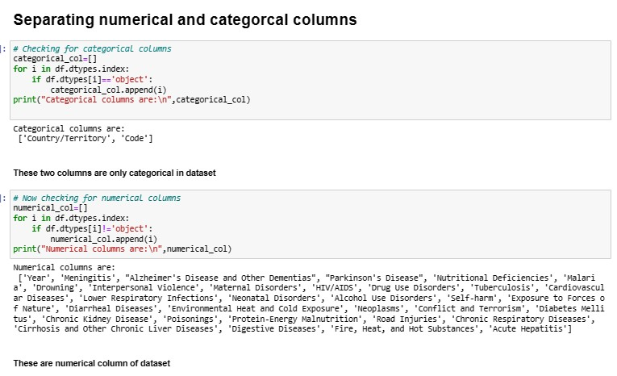
SEPRATING CATAGORICAL AND NUMERICAL COLUMNS FROM THE DATASET :-
AS TOLD ABOVE WE KNOW THAT WE HAVE 2 CATAGORICAL COLUMNS OUT OF 34 COLUMNS AND REST ALL 32 COLUMNS ARE NUMERICAL COLUMNS.

Slide 12
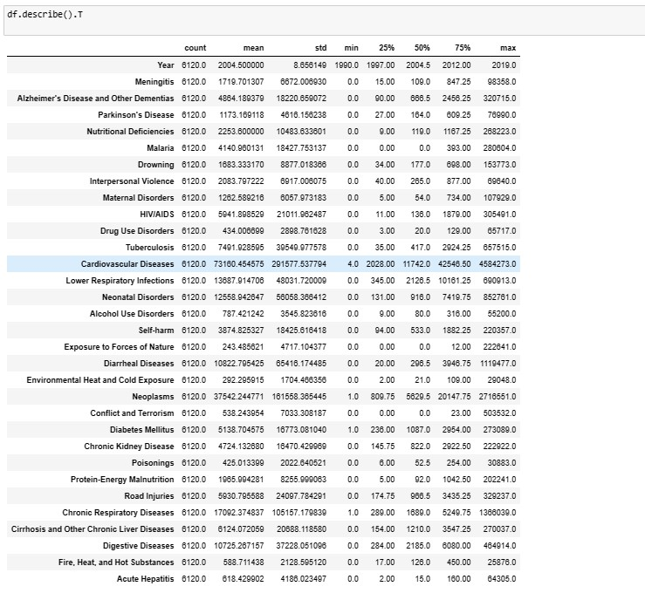
LETS DESCRIBE THE DATASET:-
Here we have described the whole dataset by DESCRIBE command .
We can see the count of all the columns that is 6120 which means no Null value is present in the dataset.
We can see the mean and standard deviation of all the Numeric columns in the dataset.
We can see the Min and Max from all the columns.
We can see Quartiles over here too

Slide 13
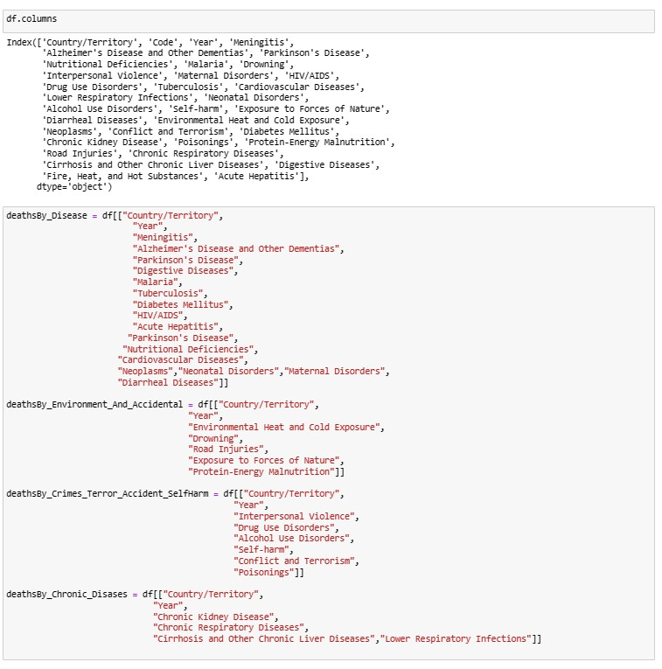
VISUALIZATIONS:-
NOW LET’S DIVIDE ALL THE FACTORS OF DEATH INTO 4 CATAGORIES :-

Slide 14
THESE 4 CATAGORIES ARE :-
DEATH BY DISEASES
DEATH BY ENVIORNMENT AND ACCIDENT.
DEATH BY CRIME
,TERROR,SELF-HARM AND ACCIDENT.
DEATH BY CRONIC DISEASES.
NOW DO THE ANALYSIS AS PER THE DEATH BY
DISEASES :-

Slide 15
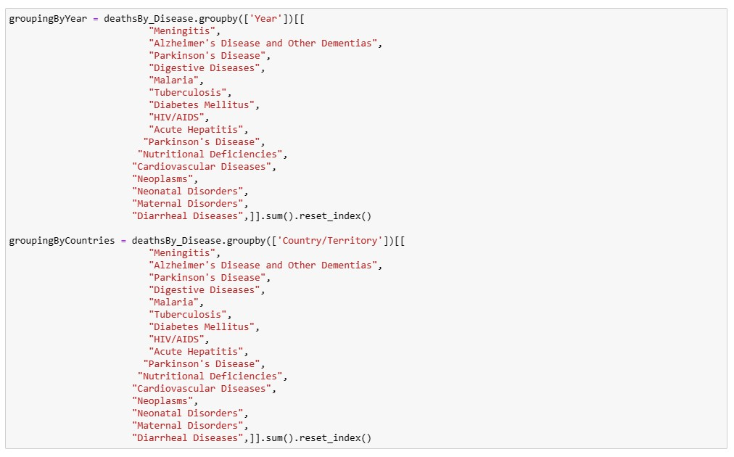
HERE I HAVE DONE GROUPING OF YEAR AND COUNTRIES ON THE BASIS OF DISEASES .

Slide 16
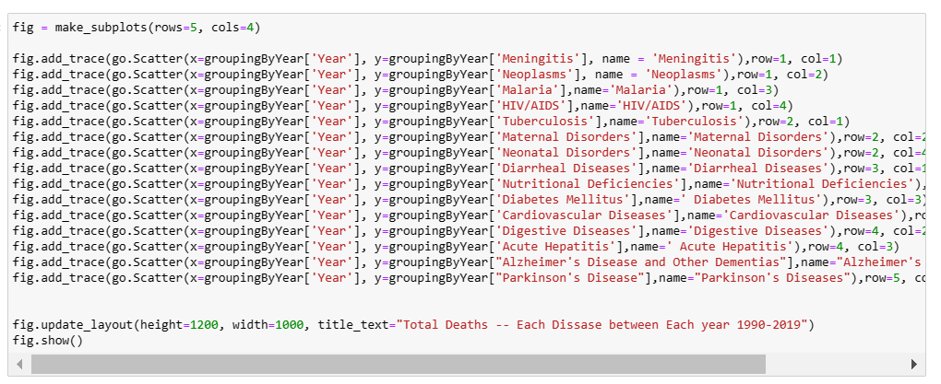
NOW DO PLOTTING OF DEATH BY DISEASES:-

Slide 17
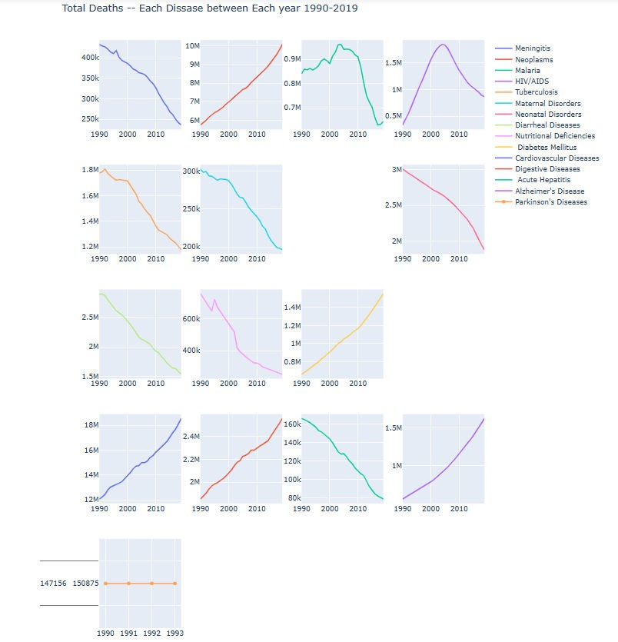
This is Plot shows how much Death has taken places by Diseases In all the year since 1990- 2019.

Slide 18
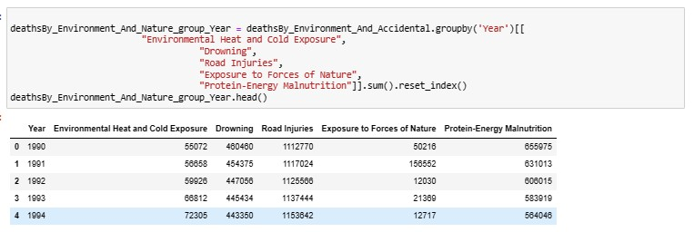
NOW LET’S SEE DEATHS TAKEN PLACE BY ENVIORNMENT AND ACCIDENT.
I HAVE DONE GROUPBY OF ALL THE DEATH ACCORDING TO YEAR WHICH FALLS UNDER THIS CATEGORY.

Slide 19
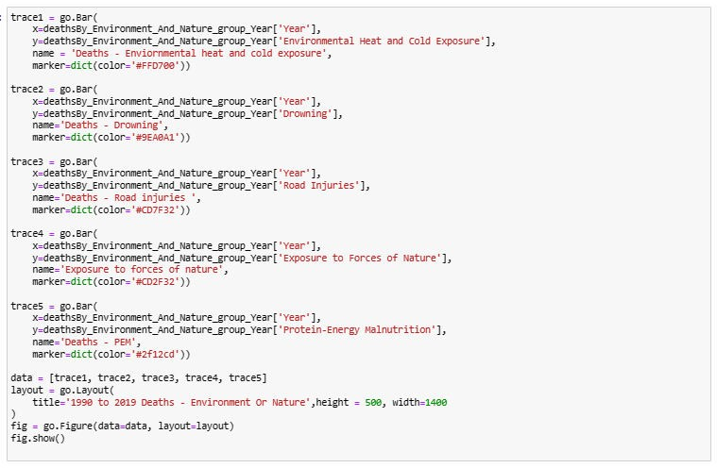
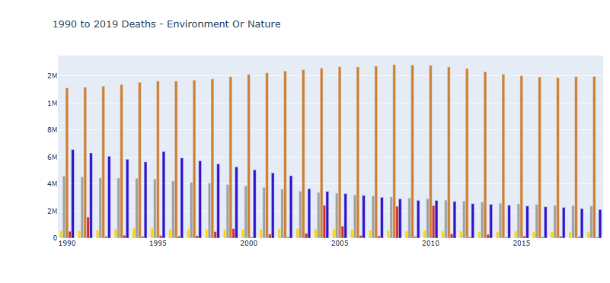

Slide 20
Here following colour is representing following columns :-
Yellow:- Environmental Heat and Cold Exposure
Grey :- Deaths - Drowning
Orange :- Road Injuries
Blue :- Protein-Energy Malnutrition(PEM)
This plot shows the total number of deaths caused by Environment_And_Accidental in year 1990 TO 2019. Here we can notice the least and the max death that took place in all the 4 categories in all the given year.

Slide 21
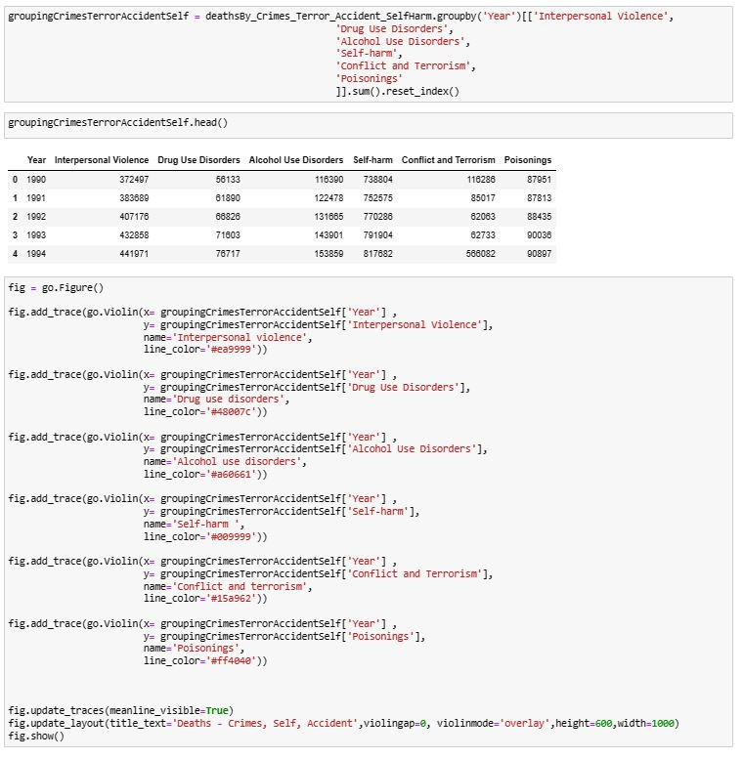
DEATH BY CRIME , TERROR
,SELF-HARM AND ACCIDENT.

Slide 22
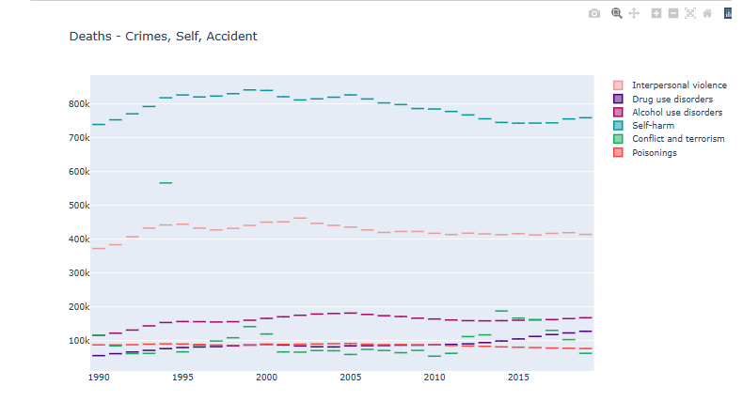
We can clearly see in this plot which shows CRIMES_TERROR_ACCIDENT_SELF-HARM and here
come to know that in all the years the maximum death have
been taken place by Conflicts and Terrorism and the max death was in between 1990 and 2000.
Poisoning seems to be constant in all the years.
The second highest death has taken place by Interpersonal violence
And rest all the case of seems to be under 200k in all the given years.

Slide 23
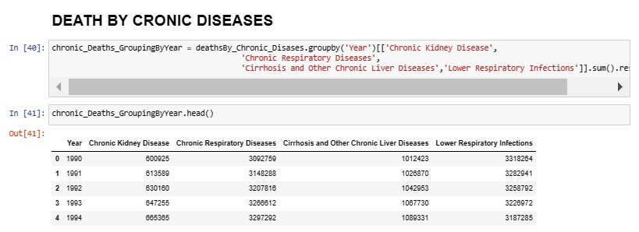
DEATH BY CHRONIC DISEASES
:-
Now do grouping of chronic diseases as per year and relevant diseases.

Slide 24
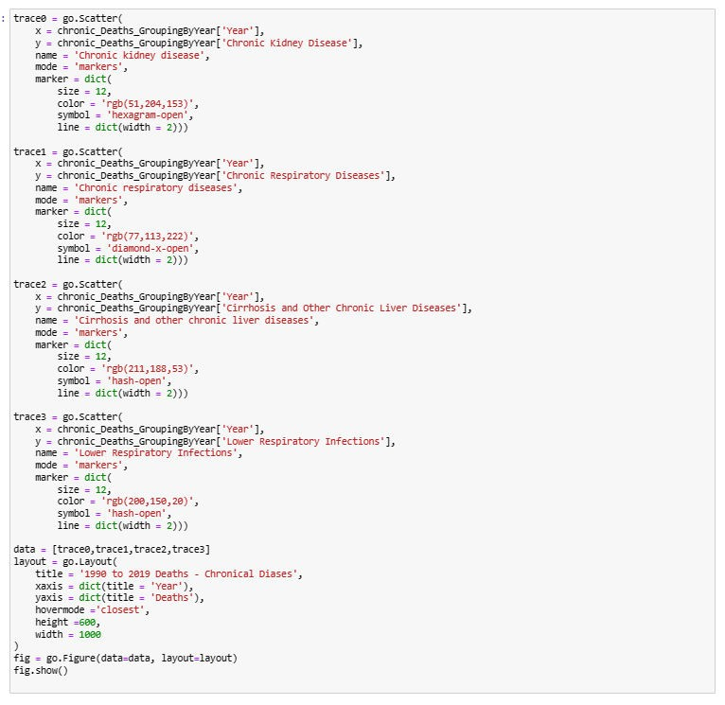

Slide 25
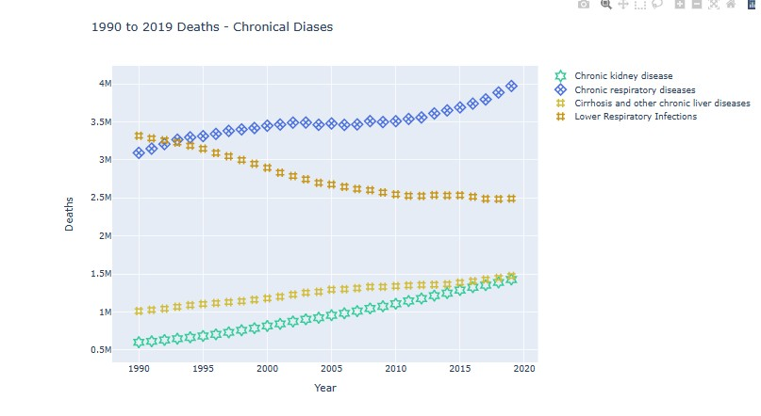
WE CAN SEE THAT THE MAXIMUM DEATH IS CAUSED BY CHRONIC RESPIRATORY DISEASES AND LEAST DEATH IS CAUSED BY CHRONIC KIDNEY DISEASES IN ALL THE GIVEN YEARS WHICH IS 1990 TO 2019.
CONCLUSION:
Total rows 6120 and 34 columns in the dataset.
I found out that there are many diseases which continuously increasing such as Neoplasms, HIV/AIDS, Diabetes, Cardiovascular Diseases, Digestive disorder and Alzheimer

Slide 26
I Found out that there are many diseases which are continuously decreasing too such as Acute Hepatitis, Diarrheal Diseases, Nutritional Diseases and Meningitis
Parkinson Diseases seems to be constants till 1990 to 1993 after that no data is present for the same.
We can see that in all the given years i.e. 1990 to 2019, Road accident have taken Maximum life’s and the least can death can be seen in Exposure to force of Nature
In case of Death by crime, self-harm and Accident -> Maximum death have been taken place by Conflict and Terrorism and the second highest death have been recorded by -Interpersonal Violence.
Rest all other factors of death are under 200k which can be even further minimized
ALL THE GOVERNMENT AND CONCERNED BODIES SHOULD TAKE RESONABLE STEP TO ENSURE THAT ALL THE AREAS WITH MAXIMUM DEATHS CAN BE MINIMIZED AND PROPER ACTION SHOULD BE TAKEN
IN CASE OF CONFLICT &TERRIOSM AND INTERPERSONAL VIOLENCE SO THAT IT SHOULD BE REDUCED TO MINIMAL.

